Slide 1
Happy Ramanavami

Slide 2
Your behavior
Did you ever look into your behavior?
Why do you behave in a particular way?
Is it appropriate behavior?
How can you change your behavior, if you think so?
Most of the people who fail in their career
it’s due to their behavior
Not due to their competence !
So, the first thing is to watch your behavior

Slide 3
CS 211 Computer Architecture Lecture 36: Cache Memory organization – Set Associative Caches
Ravi Mittal
ravi.mittal@iitgoa.ac.in
Indian Institute of Technology, Goa

Slide 4
Acknowledgements
Krste Asanović & Randy H. Katz, CS 61C: Great Ideas in Computer Architecture (Machine Structures), http://inst.eecs.berkeley.edu/~cs61c/
Chapter 6, Memory Hierarchy, Book: Computer Systems: A programmer’s perspective, Randal E. Bryant and David R. O’Hallaron
Prof Onur Mutlu’s Class Presentation, ETH Zürich, Lecture 21b: Memory Hierarchy and Caches, Sprint 2020
Patterson and Hennessy, Book: Computer Organization and Design, Hardware/Software Interface, RISC-V Edition
MIT 6.004 Spring 2020, Class on Caches
Digital Design and Computer Architecture: RISC-V Edition, Harris & Harris Elsevier

Slide 5
In this class we will study
Review of Cache concepts
Direct Mapped Cache
Set Associative Cache
Fully Associative Cache
Cache and Associativity

Slide 6
Last Class

Slide 7
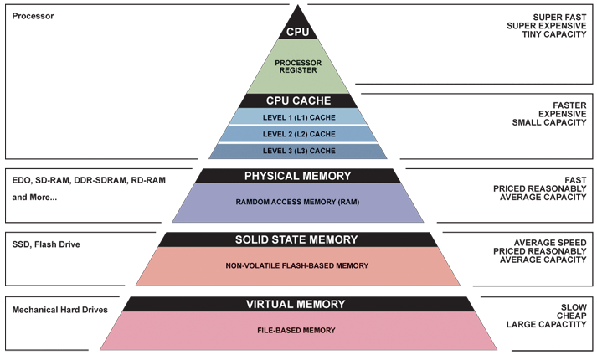
Great Idea: Principle of Locality/Memory Hierarchy
Ref: Krste Asanović & Randy H. Katz, Univ of California, Berkeley

Slide 8
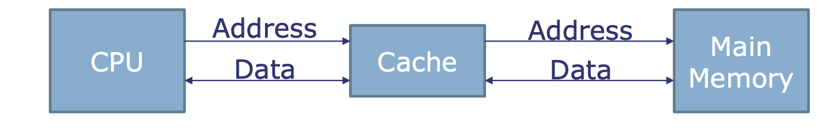
Cache Memory
Ref: MIT Course 6.004 Computation Structures

Slide 9
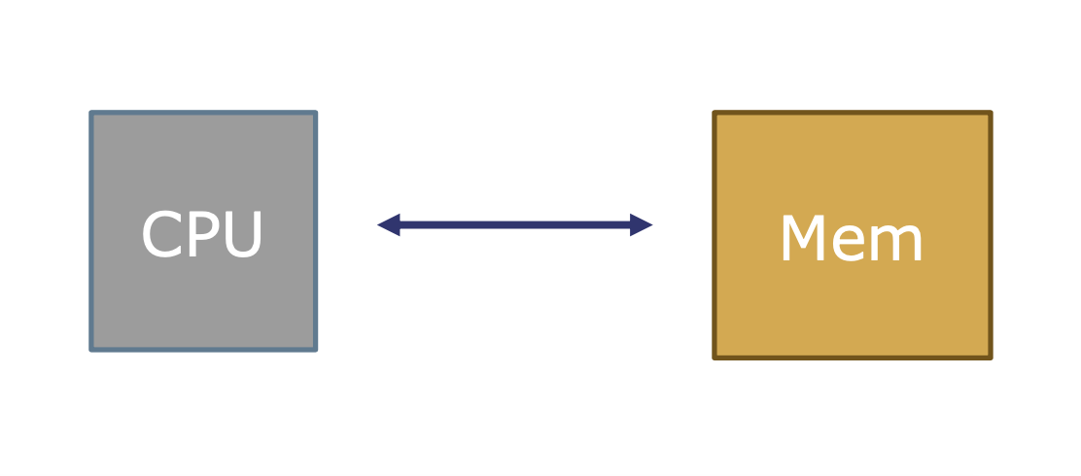
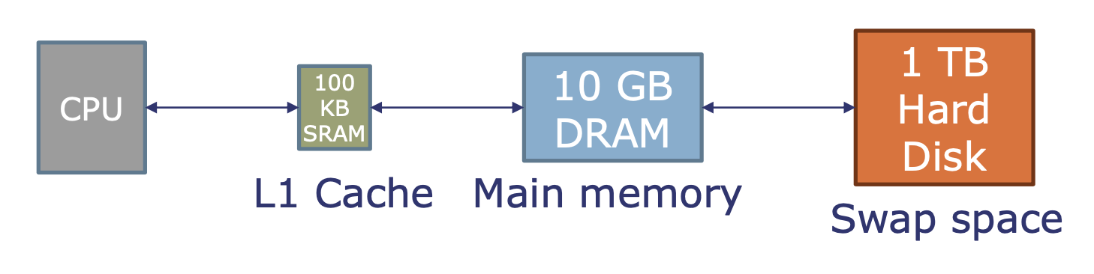
Memory Hierarchy Interface
Programming model: Single memory, single address space
Machine transparently stores data in fast or slow memory, depending on usage patterns
Ref: MIT Course 6.004 Computation Structures

Slide 10
Cache – Main Memory Interaction
Smaller, faster, more expensive
memory caches a subset of
the blocks
Cache
8
4
9
14
10
3
Data is copied in block-sized transfer units
4
10
Larger, slower, cheaper memory
viewed as partitioned into “blocks”
Memory
0
1
2
3
4
4
5
6
7
8
9
10
10
11
12
13
14
15
Bryant and O’Hallaron, Computer Systems: A Programmer’s Perspective, Third Edition

Slide 11
Cache : Hit
Request: 14
Data in block b is needed
Block b is in cache:
Hit!
Cache
8
9
14
3
14
Memory
0
1
2
3
4
5
6
7
8
9
10
11
12
13
14
15
Bryant and O’Hallaron, Computer Systems: A Programmer’s Perspective, Third Edition

Slide 12
Cache: Miss
Request: 12
Data in block b is needed
Block b is not in cache:
Miss!
Cache
8
9
14
3
12
Block b is fetched from
memory
12
Request: 12
Block b is stored in cache
Placement policy: determines where b goes
Replacement policy: determines which block gets evicted (victim)
Memory
0
1
2
3
4
5
6
7
8
9
10
11
12
12
13
14
15
Bryant and O’Hallaron, Computer Systems: A Programmer’s Perspective, Third Edition

Slide 13
Direct Mapped Cache

Slide 14
Direct Mapped Cache
Each memory location is mapped to exactly one location in the cache
Hence called Direct Mapped Cache
Therefore, we only need to look in a single location in the cache for the data if it exists in the cache
Block is the unit of transfer between cache and memory
Word Block and Line are used interchangeably
Though some authors define line as block + Tag + valid bit

Slide 15
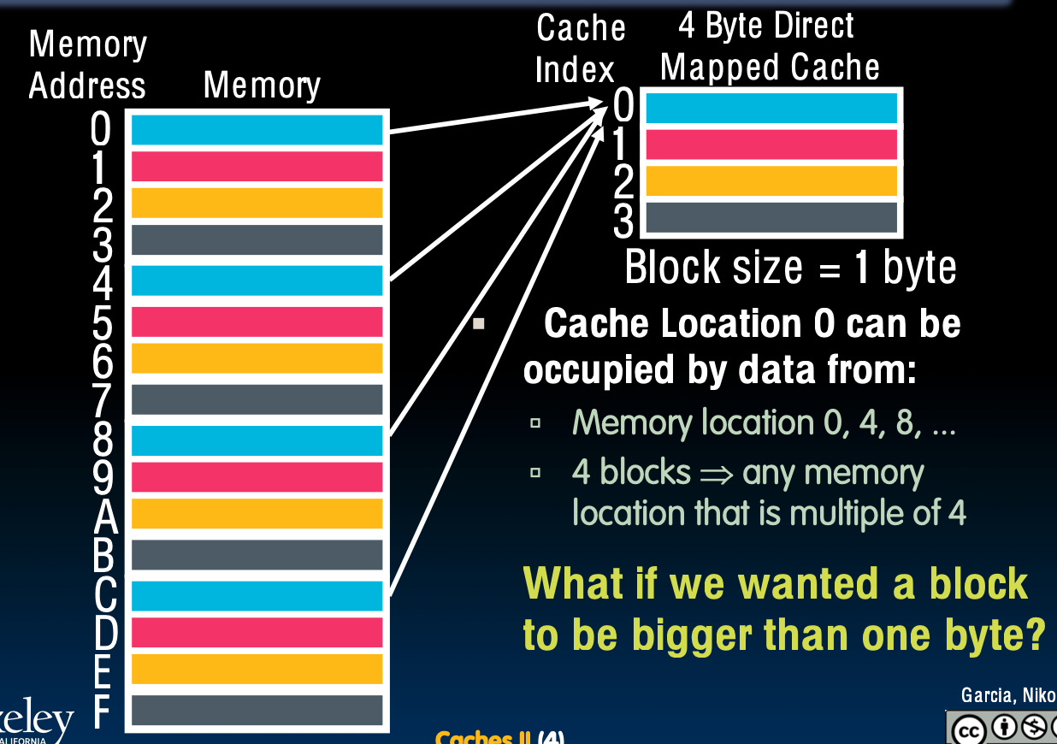


Direct Mapped Cache: Block Size 1 byte
Ref: Dan Garcia Univ of California, Berkeley

Slide 16
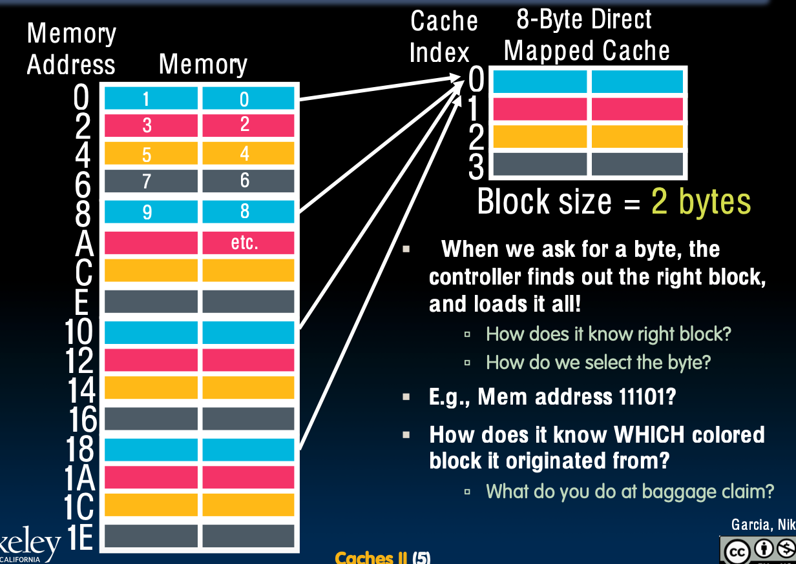

Direct Mapped Cache: Block Size 2 bytes
16 blocks → 4 blocks
Ref: Dan Garcia Univ of California, Berkeley

Slide 17
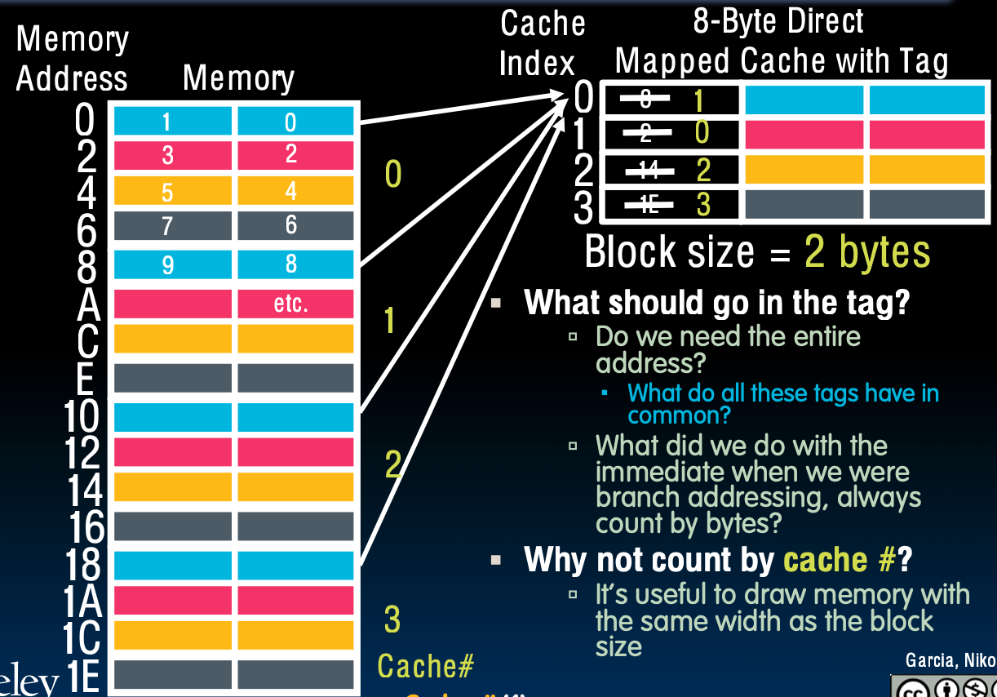

Direct Mapped Cache: Use Tag
8
2
14
1E
Ref: Dan Garcia Univ of California, Berkeley

Slide 18
Direct Mapped Cache: Block Size 2 bytes
1
0
2
3
Ref: Dan Garcia Univ of California, Berkeley

Slide 19
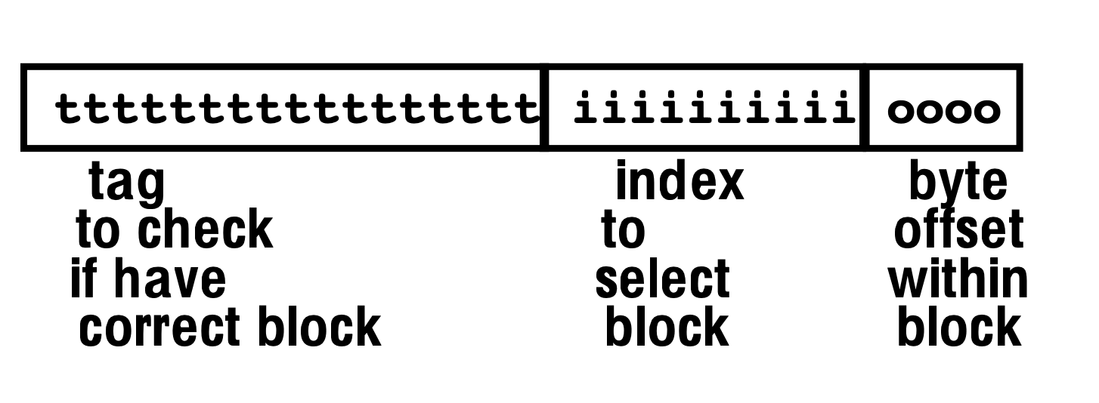
Direct Mapped Caches – address parts
Since multiple memory addresses map to the same cache index, how do we know which one is there?
What if the block size is > 1 ?
Answer: divide memory address into three fields
Ref: Dan Garcia Univ of California, Berkeley

Slide 20
Direct-Mapped Cache Terminology
All fields are read as unsigned integers.
Index
specifies the cache index (which “row”/”set” of the cache we should look in)
Which colour we must look into – in previous example
Tag
These are used to distinguish between all the memory addresses that map to the same location (all the same color blocks in MM that map to one block in Cache
Tag – Higher order bits
Offset
once we’ve found correct block, specifies which byte within the block we want

Slide 21
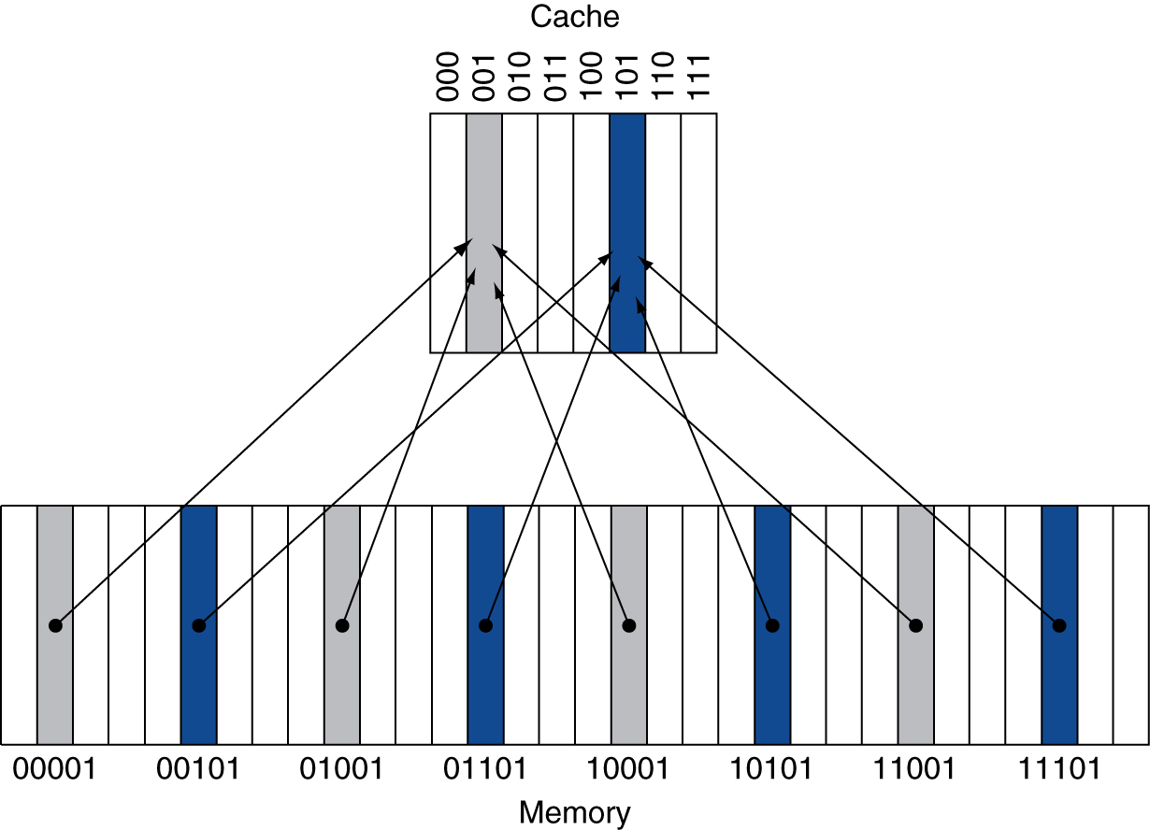
Direct Mapped Cache – Example 1
Main Memory: 32 words (bytes) that maps to 8 words (bytes) of cache
Cache: 8-blocks that uses the three lowest bits (8=2³) of the block address
Each block consists of one word (one byte)
What if there is no data in a location?
Valid bit (V): 1 = present, 0 = not present
Initially 0
Address of word:
2 bits
3 bits
0 bits
tag
Index
or set
block
offset
Ref: Patterson and Hennessey: Computer Organization and Design

Slide 22
Direct Mapped Cache: Example 1
Cache: 8-blocks, 1 word/block, direct mapped
MM: 32 blocks → Cache 8 blocks mapping
Initial state
Index | V | Tag | Data
000 | N
001 | N
010 | N
011 | N
100 | N
101 | N
110 | N
111 | N
Ref: Patterson and Hennessey: Computer Organization and Design

Slide 23
Direct Mapped Cache: Example 1
Word addr | Binary addr | Hit/miss | Cache block
22 | 10 110 | Miss | 110
Index | V | Tag | Data
000 | N
001 | N
010 | N
011 | N
100 | N
101 | N
110 | Y | 10 | Mem[10110]
111 | N
Ref: Patterson and Hennessey: Computer Organization and Design

Slide 24
Direct Mapped Cache: Example 1
Word addr | Binary addr | Hit/miss | Cache block
26 | 11 010 | Miss | 010
Index | V | Tag | Data
000 | N
001 | N
010 | Y | 11 | Mem[11010]
011 | N
100 | N
101 | N
110 | Y | 10 | Mem[10110]
111 | N
Ref: Patterson and Hennessey: Computer Organization and Design

Slide 25
Direct Mapped Cache: Example 1
Word addr | Binary addr | Hit/miss | Cache block
22 | 10 110 | Hit | 110
26 | 11 010 | Hit | 010
Index | V | Tag | Data
000 | N
001 | N
010 | Y | 11 | Mem[11010]
011 | N
100 | N
101 | N
110 | Y | 10 | Mem[10110]
111 | N
Ref: Patterson and Hennessey: Computer Organization and Design

Slide 26
Direct Mapped Cache: Example 1
Word addr | Binary addr | Hit/miss | Cache block
16 | 10 000 | Miss | 000
3 | 00 011 | Miss | 011
16 | 10 000 | Hit | 000
Index | V | Tag | Data
000 | Y | 10 | Mem[10000]
001 | N
010 | Y | 11 | Mem[11010]
011 | Y | 00 | Mem[00011]
100 | N
101 | N
110 | Y | 10 | Mem[10110]
111 | N
Ref: Patterson and Hennessey: Computer Organization and Design

Slide 27
Direct Mapped Cache: Example 1
Word addr | Binary addr | Hit/miss | Cache block
18 | 10 010 | Miss | 010
Index | V | Tag | Data
000 | Y | 10 | Mem[10000]
001 | N
010 | Y | 10 | Mem[10010]
011 | Y | 00 | Mem[00011]
100 | N
101 | N
110 | Y | 10 | Mem[10110]
111 | N
Ref: Patterson and Hennessey: Computer Organization and Design

Slide 28
Blocks and Addressing the Cache
Each block maps to a location in the cache, determined by the index bits in the address
used to index into the tag and data
Cache access:
1) index into the tag and data entry (stores) with index bits in address
2) check valid bit
3) compare tag bits in address with the stored tag in tag store
If a block is in the cache (cache hit), the stored tag should be valid and match the tag of the block
tag
index
byte in block
2b
3 bits
3 bits
8-bit address
Ref: Prof Onur Mutlu’s Presentation

Slide 29
Direct-Mapped Cache: Example 2
Block: 00000
byte-addressable main memory: 256 bytes, 8-byte per block → 32 blocks
Note that we have shown block numbers in the diagram
Assume cache: 64 bytes, 8 blocks
Direct-mapped: A block can go to only one location
Addresses with same index contend for the same location - Cause conflict misses
Block: 00001
Block: 00010
Block: 00011
Block: 00100
Block: 00101
Block: 00110
Block: 00111
Block: 01000
Block: 01001
Block: 01010
tag
index
offset
Block: 01011
Tag
Data
Block: 01100
2b
3 bits
3 bits
Block: 01101
Block: 01110
Address
Block: 01111
Block: 10000
Block: 10001
Block: 10010
Block: 10011
Block: 10100
Block: 10101
V
tag
Block: 10110
byte in block:
offset
Block: 10111
Block: 11000
=?
MUX
Block: 11001
Block: 11010
Block: 11011
Hit?
Data
Block: 11100
Block: 11101
Block: 11110
Block: 11111
Main Memory

Slide 30
Direct-Mapped Cache: 1-way
tag
index
offset
Block: 00000
Block: 00001
Index
2b
3 bits
3 bits
Block: 00010
Block: 00011
000
Block: 00100
v
tag
0
1
2
3
4
5
6
7
Block: 00101
Block: 00110
001
Block: 00111
v
tag
0
1
2
3
4
5
6
7
Block: 01000
Block: 01001
Block: 01010
v
tag
0
1
2
3
4
5
6
7
Block: 01011
Block: 01100
Block: 01101
v
tag
0
1
2
3
4
5
6
7
Block: 01110
Block: 01111
Block: 10000
v
tag
0
1
2
3
4
5
6
7
Block: 10001
Block: 10010
Block: 10011
v
tag
0
1
2
3
4
5
6
7
Block: 10100
Block: 10101
Block: 10110
v
tag
0
1
2
3
4
5
6
7
Block: 10111
Block: 11000
111
v
tag
0
1
2
3
4
5
6
7
Block: 11001
Block: 11010
Block: 11011
Cache Memory
Block: 11100
Block: 11101
Block: 11110
Block: 11111
Main Memory

Slide 31
Direct-Mapped Caches - Observations
Two blocks in memory that map to the same index in the cache cannot be present in the cache at the same time
One index → one entry
Can lead to 0% hit rate if more than one block accessed in an interleaved manner map to the same index
Assume addresses A and B have the same index bits but different tag bits
A, B, A, B, A, B, A, B, … → conflict in the cache index
All accesses are conflict misses
Ref: Prof Onur Mutlu’s Presentation

Slide 32
Set Associative Caches

Slide 33
Set Associativity
In previous example, Addresses 0 and 8 always conflict in direct mapped cache
Instead of having one column of 8, have 2 columns of 4 blocks
2 blocks represent one set
Set: Set is indexed by index bits; Here each set has two blocks
Each block in a set has it’s own tag
Key idea: Associative memory within the set
+ Accommodates conflicts better (fewer conflict misses)
-- More complex, slower access, larger tag store
Ref: Prof Onur Mutlu’s Presentation

Slide 34
Set Associative Cache: 2-way
Index
Block: 00000
Block: 00001
Block: 00010
SET 0
v
tag
0
1
2
3
4
5
6
7
v
tag
0
1
2
3
4
5
6
7
Block: 00011
Block: 00100
Block: 00101
SET 1
v
tag
0
1
2
3
4
5
6
7
v
tag
0
1
2
3
4
5
6
7
Block: 00110
Block: 00111
SET 2
Block: 01000
v
tag
0
1
2
3
4
5
6
7
v
tag
0
1
2
3
4
5
6
7
Block: 01001
Block: 01010
SET 3
v
tag
0
1
2
3
4
5
6
7
v
tag
0
1
2
3
4
5
6
7
Block: 01011
Block: 01100
Block: 01101
Block: 01110
Cache Memory
Block: 01111
Block: 10000
Block: 10001
Block: 10010
Block: 10011
Index : 2 bits
Tag: 3 bits
Block: 10100
Block: 10101
Block: 10110
Block: 10111
Block: 11000
Block: 11001
Block: 11010
4 colored blocks → 2 index bits
8 blocks of the same color in MM are mapped
to 2 blocks in Cache → 3 tag bits
Block: 11011
Block: 11100
Block: 11101
Block: 11110
Block: 11111
Main Memory

Slide 35
Set Associative Cache: 2- way
tag
index
byte Offset
3b
2 bits
3 bits
Way 1
Way 0
V
tag
block
V
tag
block
SET 0
SET 1
V
tag
V
tag
SET 2
SET 3
=?
=?
MUX
Hit1
MUX
Logic
Logic
byte offset
Hit1
Hit0
Logic
Hit
Ref: Prof Onur Mutlu’s Presentation

Slide 36
Set Associative Cache: 4-way
tag
index
byte Offset
Block: 00000
1 bit
3 bits
Block: 00001
4b
Block: 00010
Block: 00011
Block: 00100
Block: 00101
Block: 00110
v
tag
0
1
2
3
4
5
6
7
v
tag
0
1
2
3
4
5
6
7
v
tag
0
1
2
3
4
5
6
7
v
tag
0
1
2
3
4
5
6
7
SET0
Block: 00111
Block: 01000
Block: 01001
v
tag
0
1
2
3
4
5
6
7
v
tag
0
1
2
3
4
5
6
7
v
tag
0
1
2
3
4
5
6
7
v
tag
0
1
2
3
4
5
6
7
SET1
Block: 01010
Block: 01011
Cache Memory
Block: 01100
Block: 01101
Block: 01110
Block: 01111
Block: 10000
Index : 1 bit
Tag: 4 bits
Block: 10001
Block: 10010
Block: 10011
Block: 10100
Block: 10101
Block: 10110
2 colored blocks → 1 index bit
16 blocks (of same color) in MM are mapped to
4 blocks (of a set) in Cache → 4 tag bits
Block: 10111
Block: 11000
Block: 11001
Block: 11010
Block: 11011
Block: 11100
Block: 11101
Block: 11110
Block: 11111
Main Memory

Slide 37
Set Associative Cache: 4 - way
tag
index
byte Offset
4b
1 bit
3 bits
Way 3
Way 2
Way 1
Way 0
V
tag
V
tag
V
tag
V
tag
SET0
SET1
Two sets
Each set has 4 blocks (Lines)
Ref: Prof Onur Mutlu’s Presentation

Slide 38
Fully Associative Cache

Slide 39
Set Associative Cache: 8-way (Fully Associative)
Block: 00000
tag
Block: 00001
index
byte Offset
Block: 00010
0 bit
3 bits
Block: 00011
5b
Block: 00100
Block: 00101
Block: 00110
Block: 00111
Block: 01000
Block: 01001
Block: 01010
v
tag
0
1
2
3
4
5
6
7
v
tag
0
1
2
3
4
5
6
7
v
tag
0
1
2
3
4
5
6
7
v
tag
0
1
2
3
4
5
6
7
v
tag
0
1
2
3
4
5
6
7
v
tag
0
1
2
3
4
5
6
7
v
tag
0
1
2
3
4
5
6
7
v
tag
0
1
2
3
4
5
6
7
Block: 01011
Block: 01100
Block: 01101
Block: 01110
Index : 0 bit
Block: 01111
Block: 10000
Block: 10001
Block: 10010
Block: 10011
Block: 10100
Tag: 5 bits : To find out the blocks that are present in
cache
Block: 10101
Block: 10110
Block: 10111
Block: 11000
Block: 11001
Block: 11010
Block: 11011
Block: 11100
Block: 11101
Block: 11110
Block: 11111
Main Memory

Slide 40
Fully Associative
tag
index
byte Offset
5b
0 bit
3 bits
Way 7
Way 6
Way 5
Way 4
Way 3
Way 2
Way 1
Way 0
V
tag
V
tag
V
tag
V
tag
V
tag
V
tag
V
tag
V
tag
SET
One set
Each set has 8 blocks (Lines)
Ref: Prof Onur Mutlu’s Presentation

Slide 41
Cache and Associativity

Slide 42
Range of Set-Associative Caches
For a fixed-size cache, and a given block size, each increase by a factor of two in associativity doubles the number of blocks per set (i.e., the number of “ways”) and halves the number of sets
Decreases the size of the index by 1 bit and increases the size of the tag by 1 bit
More Associativity (more ways)
Tag
Index
Block offset
What if we can also change the block size?
Ref: Krste Asanović & Randy H. Katz, Univ of California, Berkeley
Notes:
For class handout

Slide 43
Set Associate Caches: 1-way to 8-way
Direct Mapped: 8 blocks, 1 way, 1 tag comparator, 8 sets (1 block / set), index 3 bits
2 Way Set Associative: 8 blocks, 2 ways, 2 tag comparators, 4 sets (2 blocks/set), index 2 bits
4 Way Set Associative: 8 blocks, 4 ways, 4 tag comparators, 2 sets (4 blocks/set), index 1 bit,
Fully Associative: 8 blocks, 8 ways, 8 tag comparators, 1 set (8 blocks / set), index 0 bit
DM: 8 sets
1 way
0
2 Way SA: 4 sets
0
4 Way SA: 2 sets
0
FA: 1 set
8 ways
0
1
1
Set 0
1
1
2
2
Set 0
2
2
Set 1
3
3
3
3
4
4
4
4
5
5
Set 2
5
5
6
6
Set 1
6
6
Set 3
7
7
7
7
Ref: Krste Asanović & Randy H. Katz, Univ of California, Berkeley

Slide 44
Associative Caches: Another view
32 blocks mapped to 8 blocks in cache
Block 12 placed in 8 block cache:
Fully associative, direct mapped, 2-way set associative
S.A. Mapping = Block Number Modulo Number Sets
Fully associative:
block 12 can go anywhere
Direct mapped:
block 12 can go only into block 4 (12 mod 8)
Set associative:
block 12 can go anywhere in set 0 (12 mod 4)
Block
no.
0 1 2 3 4 5 6 7
Block
no.
0 1 2 3 4 5 6 7
Block
no.
0 1 2 3 4 5 6 7
1 Set
8 Sets
Set
0
Set
1
Set
2
Set
3
Block-frame address
Block
no.
1 1 1 1 1 1 1 1 1 1 2 2 2 2 2 2 2 2 2 2 3 3
0 1 2 3 4 5 6 7 8 9 0 1 2 3 4 5 6 7 8 9 0 1 2 3 4 5 6 7 8 9 0 1

Slide 45
Lecture Summary
Memory hierarchy exploits principle of locality to deliver lots of memory at fast speeds
Caches can be organized as
Direct mapped – A block in MM can be mapped only to one specific block in Cache
Two-way Associative – A block in MM can be mapped to any one of the two blocks in a specific set in Cache
N-way Associative – A block in MM can be mapped to any one of the N-blocks in a specific set in Cache
Fully Associative – A block in MM can be mapped to any block in the Cache
Set associativity must be properly chosen for optimal performance

Slide 46
Associativity (and Tradeoffs)
Degree of associativity: How many blocks can map to the same index (or set)?
Higher associativity
++ Higher hit rate
-- Slower cache access time (hit latency and data access latency)
-- More expensive hardware (more comparators)
Diminishing returns from higher
associativity
hit rate
associativity
Ref: Prof Onur Mutlu’s Presentation

Slide 47
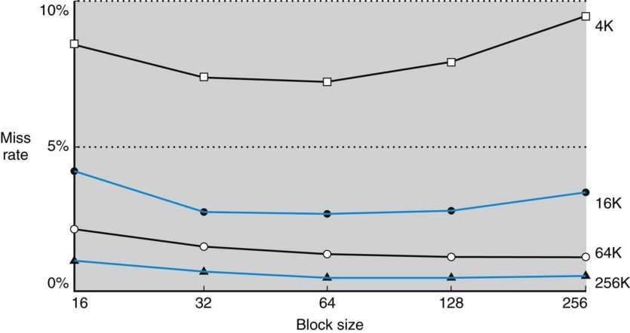
Block Size Consideration
Ref: Patterson and Hennessey: Computer Organization and Design
Larger blocks should reduce miss rate
Due to spatial locality
But in a fixed-sized cache
Larger blocks ⇒ fewer of them
More competition ⇒ increased miss rate
As a result, a block will be bumped out of the cache before many of its words are accessed
Each line represents a cache of different size.

Slide 48
Backup

Slide 49
General Cache Organization (S, E, B)
E = 2e lines per set
set
line
S = 2^{s} sets
Cache size
= S x E x B data bytes
v
tag
0
1
2
B-1
valid bit
B = 2^{b} bytes per cache block (the data)
Bryant and O’Hallaron, Computer Systems: A Programmer’s Perspective, Third Edition

Slide 50
Cache Read
Locate set
Check if any line in set has matching tag
Yes + line valid: hit
Locate data starting at offset
E = 2e lines per set
Address of word:
t bits
s bits
b bits
S = 2^{s} sets
tag
set
index
block
offset
data begins at this offset
v
tag
0
1
2
B-1
valid bit
B = 2^{b} bytes per cache block (the data)
Bryant and O’Hallaron, Computer Systems: A Programmer’s Perspective, Third Edition

Slide 51
Example: Direct Mapped Cache (E = 1)
Direct mapped: One line per set
Assume: cache block size B=8 bytes
Address of int:
v
tag
0
1
2
3
4
5
6
7
t bits
0…01
100
v
tag
0
1
2
3
4
5
6
7
find set
S = 2^{s} sets
v
tag
0
1
2
3
4
5
6
7
v
tag
0
1
2
3
4
5
6
7
Bryant and O’Hallaron, Computer Systems: A Programmer’s Perspective, Third Edition

Slide 52
Example: Direct Mapped Cache (E = 1)
Direct mapped: One line per set
Assume: cache block size B=8 bytes
Address of int:
valid? +
match: assume yes (= hit)
t bits
0…01
100
v
tag
0
1
2
3
4
5
6
7
tag
block offset
Bryant and O’Hallaron, Computer Systems: A Programmer’s Perspective, Third Edition

Slide 53
Example: Direct Mapped Cache (E = 1)
Direct mapped: One line (block) per set
Assume: cache block size B=8 bytes
Address of int:
valid? +
match: assume yes (= hit)
t bits
0…01
100
v
tag
0
1
2
3
4
5
6
7
block offset
int (4 Bytes) is here
If tag doesn’t match (= miss): old line is evicted and replaced
Bryant and O’Hallaron, Computer Systems: A Programmer’s Perspective, Third Edition

Slide 54
E-way Set Associative Cache (Here: E = 2)
E = 2: Two lines per set
Assume: cache block size B=8 bytes
Address
2 lines per set
t bits
0…01
3 bits
v
tag
0
1
2
3
4
5
6
7
v
tag
0
1
2
3
4
5
6
7
v
tag
0
1
2
3
4
5
6
7
v
tag
0
1
2
3
4
5
6
7
find set
v
tag
0
1
2
3
4
5
6
7
v
tag
0
1
2
3
4
5
6
7
v
tag
0
1
2
3
4
5
6
7
v
tag
0
1
2
3
4
5
6
7
sets
Bryant and O’Hallaron, Computer Systems: A Programmer’s Perspective, Third Edition

Slide 55
E-way Set Associative Cache (Here: E = 2)
E = 2: Two lines per set
Assume: cache block size B=8 bytes
Address of short int:
compare both
t bits
0…01
100
valid? +
match: yes (= hit)
v
tag
0
1
2
3
4
5
6
7
tag
v
tag
0
1
2
3
4
5
6
7
block offset
Bryant and O’Hallaron, Computer Systems: A Programmer’s Perspective, Third Edition

Slide 56
E-way Set Associative Cache (Here: E = 2)
E = 2: Two lines per set
Assume: cache block size B=8 bytes
Address of short int:
compare both
t bits
0…01
100
valid? +
match: yes (= hit)
v
tag
0
1
2
3
4
4
5
tag
5
6
7
v
tag
0
1
2
3
4
5
6
7
block offset
short int (2 Bytes) is here
No match or not valid (= miss):
One line in set is selected for eviction and replacement
Replacement policies: random, least recently used (LRU), …
Bryant and O’Hallaron, Computer Systems: A Programmer’s Perspective, Third Edition

Slide 57
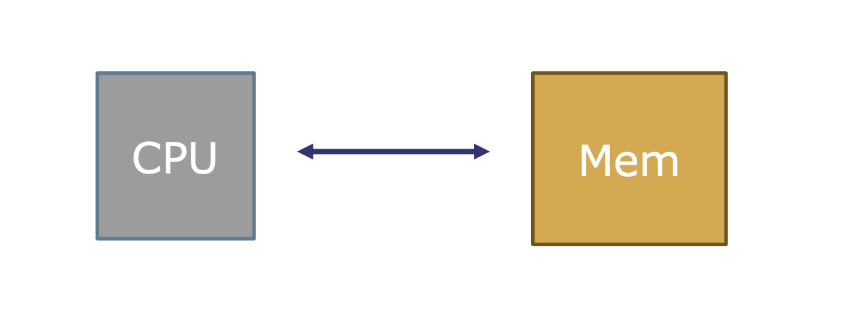
Cache Philosophy - Interface
Programming model: Single memory, single address space
Ref: MIT Course 6.004 Computation Structures

Slide 58
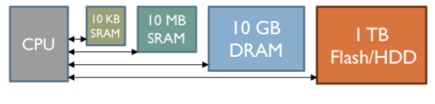
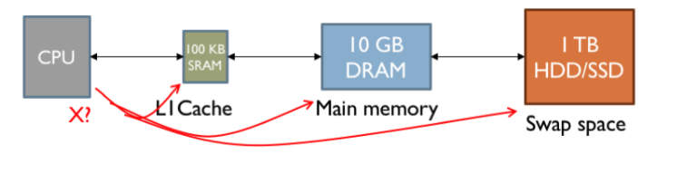
Cache Philosophy - Interface
Approach 1: Expose Hierarchy
Registers, SRAM, DRAM, Flash, Hard Disk
Tell programmer to “use them cleverly”
Approach 2: Hide Hierarchy
Programming model: Single memory, single address space
Machine transparently stores data in fast or slow memories depending on usage patterns
Ref: MIT Course 6.004 Computation Structures

Slide 59
General Notes on Caches (1/3)
Recall: Memory is byte-addressed
We haven’t specified the size of our “blocks,” but will usually be multiple of word size (32-bits)
How do we access individual words or bytes within a block?
Cache is smaller than memory
Can’t fit all blocks at once, so multiple blocks in memory must map to the same slot in cache
Need some way of identifying which memory block is currently in each cache slot
OFFSET
INDEX
TAG
Ref: Krste Asanović & Randy H. Katz, Univ of California, Berkeley
Notes:
“slot” or “cubby” or “locker” or “location”
Add cache block partitioned to words

Slide 60
General Notes on Caches (2/3)
What does cache initially hold?
Garbage! Cache considered “cold”
Keep track with Valid bit
Effect of block size (K Bytes):
Spatial locality dictates our blocks consist of adjacent bytes, which differ in address by 1
Offset field: Low bits of memory address can be used to index to specific bytes within a block
Block size needs to be a power of two (in bytes)

Slide 61
General Notes on Caches (3/3)
Effect of cache size (C Bytes):
“Cache Size” refers to total stored data
Determines number of blocks the cache can hold (C/K blocks)
Tag field: Leftover upper bits of memory address determine which portion of memory the block came from (identifier)
Notes:
Can also call tag field the “block number” (only works for fully associative).

Slide 62
Cache Abstraction and Metrics
Cache hit rate = (# hits) / (# hits + # misses) = (# hits) / (# accesses)
Average memory access time (AMAT)
= ( hit-rate * hit-latency ) + ( miss-rate * miss-latency )
Address
Tag Store
(is the address
in the cache?
+ bookkeeping)
Data Store
(stores
memory
blocks)
Hit/miss?
Data
Ref: Prof Onur Mutlu’s Presentation

Slide 63
Set Associativity
Addresses 0 and 8 always conflict in direct mapped cache
Instead of having one column of 8, have 2 columns of 4 blocks
Tag store
Data store
SET
V
tag
V
tag
=?
=?
MUX
Logic
MUX
byte in block
Address
Hit?
tag
index
byte in block
Key idea: Associative memory within the set
+ Accommodates conflicts better (fewer conflict misses)
-- More complex, slower access, larger tag store
3b
2 bits
3 bits
Ref: Prof Onur Mutlu’s Presentation

